Slide 1
Methodologies
An Overview of Traditional and Latest Approaches in Project Management
ABINAYA G

Slide 2

Introduction
This presentation explores traditional and latest methodologies in project management, examining their objectives, processes, and impact.

Slide 3
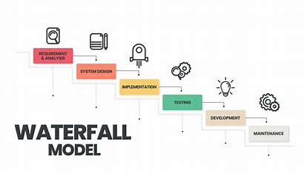
01
Traditional Methodology

Slide 4

Objectives
Plan and document everything before starting the work.
Deliver the final product only after full development and testing.
Example methods: Waterfall Model, V-Model, Spiral Model.

Slide 5
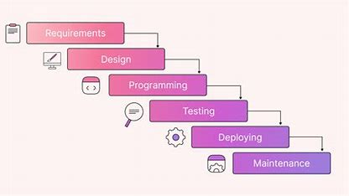
Process
Step-by-Step (Linear) process:
Requirement Gathering
System Design
Implementation
Testing
Deployment
Maintenance
Each phase must be completed before the next starts.

Slide 6
Advantages and Drawbacks
Clear structure — everyone knows what to do next.
Well-documented requirements and designs.
Easy to manage for small projects with fixed needs.
Good for regulatory or government projects.
Drawbacks
Inflexible — hard to change once started.
Late Testing — issues are found very late.
Customer Feedback comes very late (at end).
High Risk if customer needs change mid-project.

Slide 7
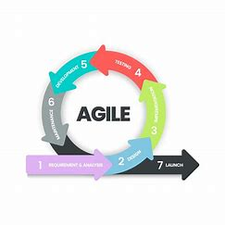
02
Latest Methodology

Slide 8
Objectives
The latest methodologies aim to enhance flexibility
Deliver working software early and continuously.
Adapt easily to changing customer needs.
Focus on collaboration, feedback, and improvement.
Example methods: Agile, Scrum, Kanban, XP (Extreme Programming).
responsiveness to change, fostering collaboration and continuous improvement within teams. They prioritize delivering value to the customer and adapting to evolving project requirements.

Slide 9
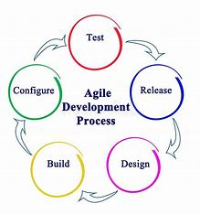
Process
Iterative and incremental approach:
Plan small
Develop small
Test immediately
Deliver quickly
Get feedback
Improve .

Slide 10

Advantages in Overcoming Traditional Drawbacks
Faster delivery of working features.
Easier to make changes anytime.
Regular customer involvement and feedback.
Reduced risk through continuous testing and improvements.
Team collaboration is strong and transparent.
Drawbacks
Needs skilled team members.
Requires strong communication and discipline.
Hard to predict costs if requirements keep changing.
May not suit projects where fixed cost and scope are mandatory.

Slide 11
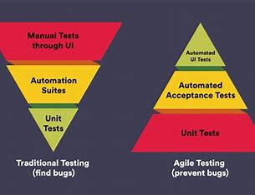
Conclusions
In conclusion, while traditional methodologies provide structure, they may hinder adaptability. The latest methodologies focus on agility and continuous improvement, which can lead to better project outcomes and enhanced responsiveness to change.

